Slide 1

INTRODUCTION to COMPUTATION & PROGRAMMING FOR IE
Assoc. Prof. Dr. Gürkan ÖZTÜRK & Assist. Prof. Dr. Emre ÇİMEN
gurkan.o@eskisehir.edu.tr & ecimen@eskisehir.edu.tr
Week 11

Slide 2

STRUCTURED TYPES, MUTABILITY, AND HIGHER- ORDER FUNCTIONS
The programs we have looked at thus far have dealt with three types of objects: int, float, and str.
The numeric types int and float are scalar types. That is to say, objects without accessible internal structure.
str can be thought of as a structured, or non-scalar, type. One can use indexing to extract individual characters from a string and slicing to extract substrings.

Slide 3
STRUCTURED TYPES, MUTABILITY, AND HIGHER- ORDER FUNCTIONS
In this part, we will introduce three structured types. One, tuple, is a rather simple generalization of str. The other two, list and dict, are more interesting—in part because they are mutable.
Tuples
Lists
Dictionaries

Slide 4
Tuples
Like strings, tuples are ordered sequences of elements.
The difference is that the elements of a tuple need not be characters. The individual elements can be of any type, and need not be of the same type as each other.
Literals of type tuple are written by enclosing a comma-separated list of elements within parentheses.
t1 = ()
t2 = (1, 'two', 3)
print t1
print t2
()
(1, 'two', 3)

Slide 5
Like strings, tuples can be concatenated, indexed, and sliced.
t1 = (1, 'two', 3)
t2 = (t1, 3.25)
print(t2)
print((t1 + t2))
print((t1 + t2)[3])
print((t1 + t2)[2:5])
((1, 'two', 3), 3.25)
(1, 'two', 3, (1, 'two', 3), 3.25)
(1, 'two', 3)
(3, (1, 'two', 3), 3.25)

Slide 6
A for statement can be used to iterate over the elements of a tuple.
def findDivisors (n1, n2):
"""Assumes that n1 and n2 are positive ints
Returns a tuple containing all common divisors of n1 & n2""”
divisors = () #the empty tuple
for i in range(1, min (n1, n2) + 1):
if n1%i == 0 and n2%i == 0:
divisors = divisors + (i,)
return divisors
divisors = findDivisors(20, 100)
print(divisors)
total = 0
for d in divisors:
total += d
print(total)
Will print:
(1, 2, 4, 5, 10, 20)
42

Slide 7
Sequences and Multiple Assignments
If you know the length of a sequence (e.g., a tuple or a string), it can be convenient to use Python’s multiple assignment statement to extract the individual elements.
After executing the statement x, y = (3, 4), x will be bound to 3 and y to 4. Similarly, the statement a, b, c = 'xyz’ will bind a to 'x’, b to 'y', and c to 'z'.

Slide 8
This mechanism is particularly convenient when used in conjunction with functions that return fixed-size sequences.
def findExtremeDivisors(n1, n2):
"""Assumes that n1 and n2 are positive ints
Returns a tuple containing the smallest common divisor > 1 and the largest common divisor of n1 and n2"""
minVal, maxVal = None, None
for i in range(2, min(n1, n2) + 1):
if n1%i == 0 and n2%i == 0:
if minVal == None or i < minVal:
minVal = i
if maxVal == None or i > maxVal:
maxVal = i
return (minVal, maxVal)
minDivisor, maxDivisor = findExtremeDivisors(100, 200)
minDivisor will be 2
maxDivisor will be 100

Slide 9
Lists and Mutability
Like a tuple, a list is an ordered sequence of values, where each value is identified by an index.
The syntax for expressing literals of type list is similar to that used for tuples; the difference is that we use square brackets rather than parentheses.

Slide 10
Lists and Mutability
The empty list is written as [ ], and singleton lists are written without comma before the closing bracket.
L = ['I did it all', 4, 'love’]
for i in range(len(L)):
print(L[i])
Produces output:
I did it all
4
love

Slide 11
Lists and Mutability
The fact that square brackets are used for literals of type list, indexing into lists, and slicing lists can lead to some visual confusion.
For example, the expression [1,2,3,4][1:3][1], which evaluates to 3, uses the square brackets in three different ways.
This is rarely a problem in practice, because most of the time lists are built incrementally rather than written as literals.

Slide 12
Lists and Mutability
Lists differ from tuples in one hugely important way: lists are mutable.
In contrast, tuples and strings are immutable. There are many operators that can be used to create objects of these immutable types, and variables can be bound to objects of these types.
But objects of immutable types cannot be modified. On the other hand, objects of type list can be modified after they are created.

Slide 13
Lists and Mutability
The distinction between mutating an object and assigning an object to a variable may, at first, appear subtle.
“In Python a variable is merely a name, i.e., a label that can be attached to an object,” it will bring you clarity.

Slide 14
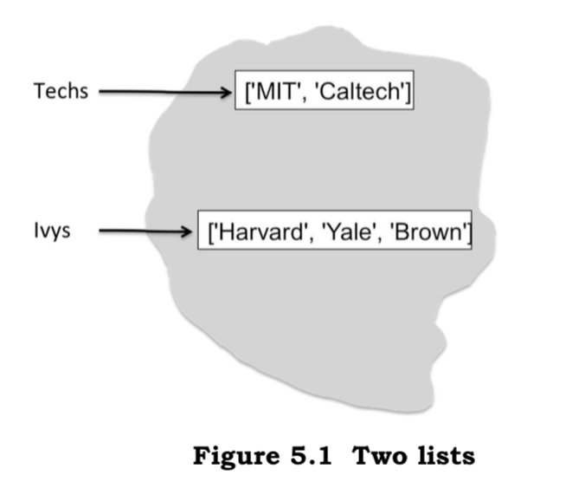
Lists and Mutability
When the statements
  Techs = ['MIT', 'Caltech’]
  Ivys = ['Harvard', 'Yale', 'Brown']
are executed, the interpreter creates two new lists and binds the appropriate variables to them, as pictured below.

Slide 15
Lists
The assignment statements
Univs = [Techs, Ivys]
Univs1 = [['MIT', 'Caltech'], ['Harvard', 'Yale', 'Brown']]
also create new lists and bind variables to them. The elements of these lists are themselves lists.
print('Univs =', Univs)
Print('Univs1 =', Univs1)
Print(Univs == Univs1)
Will produce
the output:
Univs = [['MIT', 'Caltech'], ['Harvard', 'Yale', 'Brown’]]
Univs1 = [['MIT', 'Caltech'], ['Harvard', 'Yale', 'Brown’]]
True

Slide 16
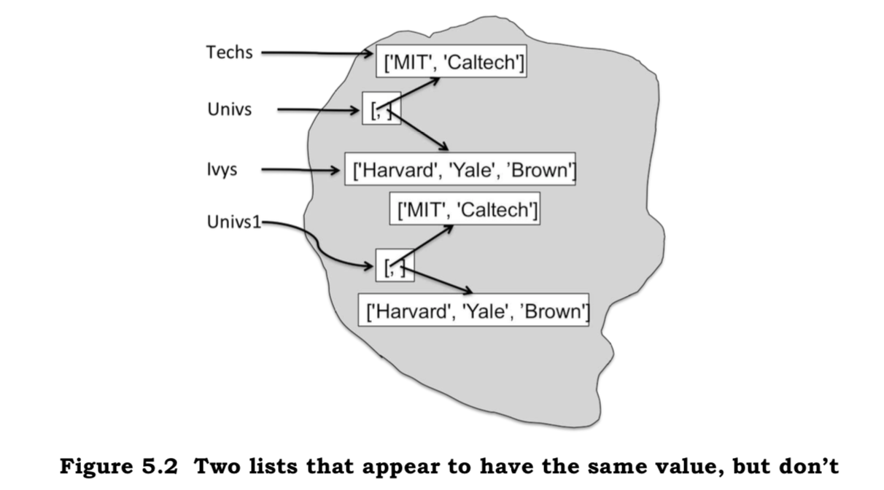
Lists
It appears as if Univs and Univs1 are bound to the same value.
But appearances can be deceiving. As the following picture illustrates, Univs and Univs1 are bound to quite different values.

Slide 17
Lists
That Univs and Univs1 are bound to different objects can be verified using the built-in Python function id, which returns a unique integer identifier for an object.
This function allows us to test for object equality.
When we run the code:
Print(Univs == Univs1) #test value equality
Print(id(Univs) == id(Univs1)) #test object equality
Print('Id of Univs =', id(Univs))
Print('Id of Univs1 =', id(Univs1))
It prints:
True
False
Id of Univs = 24499264
Id of Univs1 = 24500504

Slide 18
Lists
Notice that in the previous Figure 5.2 the elements of Univs are not copies of the lists to which Techs and Ivys are bound, but are rather the lists themselves. The elements of Univs1 are lists that contain the same elements as the lists in Univs, but they are not the same lists.
When we run the code:
Print ('Ids of Univs[0] and Univs[1]', id(Univs[0]), id(Univs[1]))
Print ('Ids of Univs1[0] and Univs1[1]', id(Univs1[0]), id(Univs1[1]))
It prints:
Ids of Univs[0] and Univs[1] 22287944 22286464
Ids of Univs1[0] and Univs1[1] 22184184 22287984

Slide 19
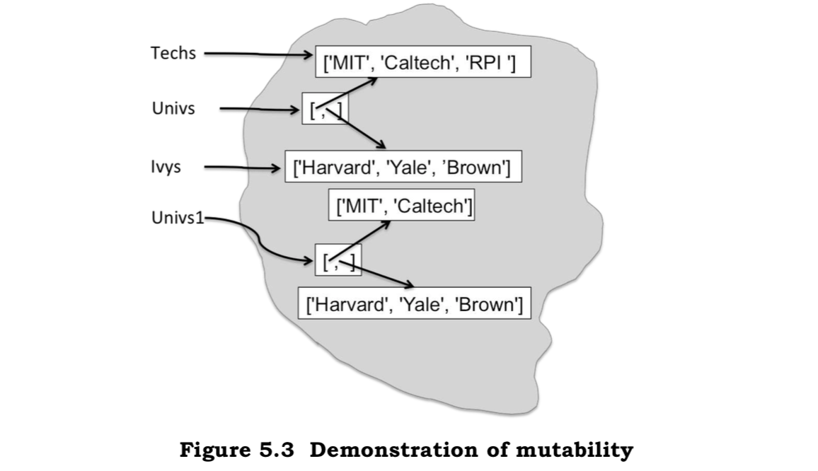
Why does it matter?
It matters because lists are mutable.
Consider the code :
Techs.append('RPI')
The append method has a side effect. Rather than create a new list, it mutates the existing list Techs by adding a new element, the string 'RPI', to the end of it. After append is executed, the state of the computation looks like :

Slide 20
Lists
Univs still contains the same two lists, but the contents of one of those lists has been changed.
Consequently, the print statements:
Print ('Univs’, Univs)
Print ('Univs1’, Univs1)
It prints:
Univs = [['MIT', 'Caltech', 'RPI'], ['Harvard', 'Yale', 'Brown’]]
Univs1 = [['MIT', 'Caltech'], ['Harvard', 'Yale', 'Brown']]

Slide 21
Lists
What we have here is something called aliasing.
One path is through the variable Techs
the other through the first element of the list object to which Univs is bound.
There are two distinct paths to the same list object.

Slide 22
Lists
One can mutate the object via either path, and the effect of the mutation will be visible through both paths.
Obj
Unintentional aliasing leads to programming errors that are often enormously hard to track down !

Slide 23
Lists
As with tuples, a for statement can be used to iterate over the elements of a list.
Will print :
for e in Univs:
print ('Univs contains’, e)
print ('which contains’)
for u in e:
print( ‘ ‘, u)
Univs contains ['MIT', 'Caltech', 'RPI’]
which contains
MIT
Caltech
RPI
Univs contains ['Harvard', 'Yale', 'Brown’]
which contains
Harvard
Yale
Brown

Slide 24
Lists
When we append one list to another, e.g., Techs.append(Ivys), the original structure is maintained. i.e., the result is a list that contains a list.
Suppose we do not want to maintain this structure, but want to add the elements of one list into another list.
We can do that by using list concatenation or the extend method, e.g.,
L1 = [1, 2, 3]
L2 = [4, 5, 6]
L3 = L1 + L2
Print('L3 =‘, L3)
L1.extend(L2)
Print('L1 =‘, L1)
L1.append(L2)
Print('L1 =', L1)
Will print :
L3 = [1, 2, 3, 4, 5, 6]
L1 = [1, 2, 3, 4, 5, 6]
L1 = [1, 2, 3, 4, 5, 6, [4, 5, 6]]
Notice that the operator + does not have a side effect.

Slide 25
Methods associated with lists
L.append(e)
adds the object e to the end of L.
L.count(e)
returns the number of times that e occurs in L.
L.insert(i, e)
inserts the object e into L at index i.
L.extend(L1)
adds the items in list L1 to the end of L.
L.remove(e)
deletes the first occurrence of e from L.
L.index(e)
returns the index of the first occurrence of e in L.
L.pop(i)
removes and returns the item at index i in L.
L.sort()
L.reverse()
reverses the order of the elements in L.
sorts the elements of L in ascending order.

Slide 26

Cloning
Though allowed, it is usually prudent to avoid mutating a list over which one is iterating. Consider, for example, the code :
def removeDups(L1, L2):
"""Assumes that L1 and L2 are lists.
Removes any element from L1 that also occurs in L2"""
for e1 in L1:
if e1 in L2:
L1.remove(e1)
L1 = [1,2,3,4]
L2 = [1,2,5,6]
removeDups(L1, L2)
Print('L1 =', L1 )
Will print :
L1 = [2, 3, 4]

Slide 27
Cloning
One way to avoid this kind of problem is to use slicing to clone (i.e., make a copy of) the list and write for e1 in L1[:].
Notice that writing newL1 = L1 followed by for e1 in newL1 would not have solved the problem. It would not have created a copy of L1, but would merely have introduced a new name for the existing list.
Slicing is not the only way to clone lists in Python. The expression list(l) returns a copy of the list l. If the list to be copied contains mutable objects that you want to copy as well, import the standard library module copy and use the function copy.deepcopy.

Slide 28
List Comprehension
List comprehension provides a concise way to apply an operation to the values in a sequence. It creates a new list in which each element is the result of applying a given operation to a value from a sequence (e.g., the elements in another list).
L = [x**2 for x in range(1,7)]
Print(L)
Will print the list :
[1, 4, 9, 16, 25, 36]

Slide 29
List Comprehension
The for clause in a list comprehension can be followed by one or more if and for statements that are applied to the values produced by the for clause.
These additional clauses modify the sequence of values generated by the first for clause and produce a new sequence of values, to which the operation associated with the comprehension is applied.
mixed = [1, 2, 'a', 3, 4.0]
print([x**2 for x in mixed if type(x) == int])
Will print the list :
[1, 4, 9]
Remember that somebody else may need to read your code!

Slide 30
References
John V. Guttag, Introduction to Computation and Programming Using Python, The MIT Press Cambridge, Massachusetts London, England, 2013

Slide 31
INTRODUCTION to COMPUTATION & PROGRAMMING FOR IE
Assoc. Prof. Dr. Gürkan ÖZTÜRK & Assist. Prof. Dr. Emre ÇİMEN
gurkan.o@eskisehir.edu.tr & ecimen@eskisehir.edu.tr
Week 11

